Slide 1
America Becomes a World Power
1898-1917

Slide 2
American Foreign Policy Expands
Imperialism—Action of a nation/nations to conquer lesser nations and/or add colonial territories
European Imperialism
Spain, Britain, France, The Netherlands, Germany, and Austria-Hungary
targeted under-developed Africa/Asia—raw materials/riches
many were adding to existing empires (Great Britain and France)
others wanted to acquire new colonial empires (Germany)
some hung on to existing empires (Spain/Austria-Hungary)
Little or no regard for existing governments or boundaries
Led to a European arms race—build-up of military technology

Slide 3
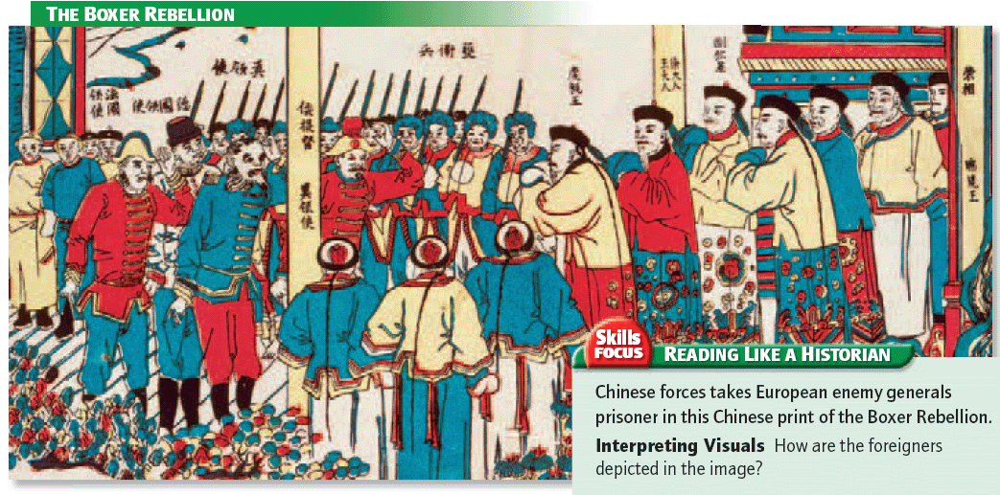

Slide 4
American Foreign Policy Expands (continued)
American Imperialism
Most leaders claimed that the freedom-loving American people were not capable of “imperialism”
Westward Expansion was America’s “imperialism”
US focused more on gaining access to foreign markets
by 1890, most leaders tried to negotiate with nations, not overthrow them

Slide 5
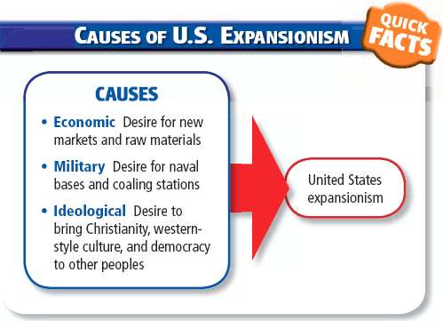

Slide 6
American Foreign Policy Expands (continued)
Spanish-American War
marked the emergence of the United States as a world power
took place between April and August 1898
issue was the liberation of Cuba
US won Guam, Puerto Rico, and the Philippines
Background of the war
Spain tightened its control on its colonies through the 1870’s
1st Revolution (1870s)—long and exhausting—put down harshly by the Spanish
Conditions worsened for Cubans in the 1880s-90s
1895—revolution broke out again—Neither side was strong enough to win

Slide 7
American Foreign Policy Expands (continued)
American intervention
Many Americans sympathized with the Cubans, but, few called for US intervention—Asst. Sec of the Navy Theodore Roosevelt did
"yellow journalism"—News reporting that exaggerates facts to interest readers and/or shape public opinion—took up the cause of Cuban Independence
Newspaper publishers William Randolph Hearst, and Joseph Pulitzer, knew war could boost newspaper sales/increase American expansion
printed sensational accounts of Spanish oppression and called for US intervention in Cuba
November 1897, President McKinley pressured Spain into granting Cuba limited self-government

Slide 8
American Foreign Policy Expands (continued)
Cuban rebels wanted independence, and continued to fight
Pro-Spanish mobs rioted in protest against self-government
To protect Americans, the battleship Maine arrived in Havana harbor January 25, 1898
February 15, an explosion blew up the ship and killed 260 on board—Spain was blamed—unknown cause
"Remember the Maine" became a popular slogan
President McKinley demanded full independence for Cuba—Spain only granted an armistice to the rebels
Congress passed a resolution asserting that Cuba was independent based on the Monroe Doctrine
Denied American intention to acquire the island
Authorized the use of military to force Spanish withdrawal
April 25—U.S. formally declared that a state of war existed with Spain

Slide 9
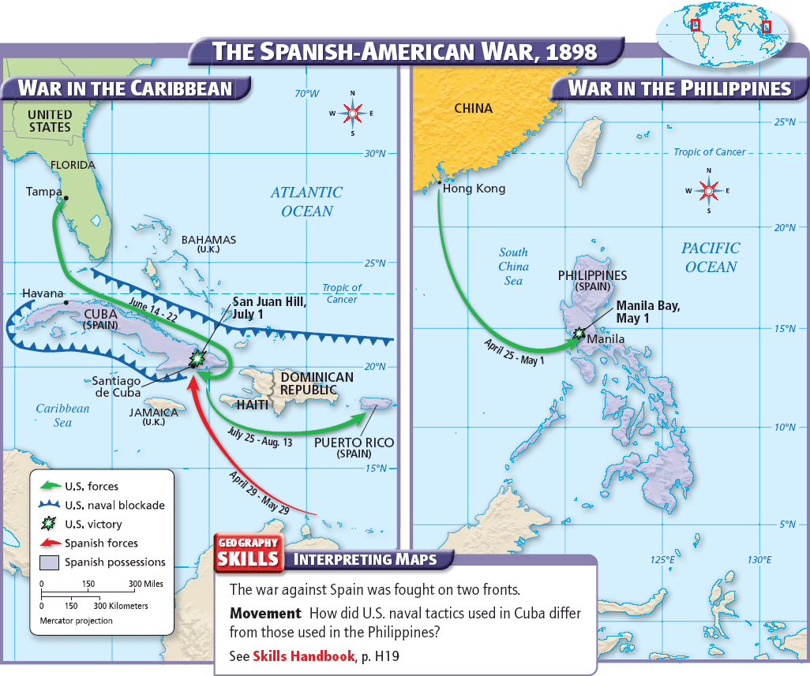

Slide 10
American Foreign Policy Expands (continued)
Key events of the war
Manila Bay—The first important battle was in the Philippines
The Asiatic Squadron (Commodore George Dewey) destroyed the entire Spanish fleet without the loss of American life or American ship
Dewey blockaded Manila harbor—waited for US troops
Cuban blockade—North Atlantic Squadron located Spain's fleet in the harbor of Santiago de Cuba
Placed a blockading force outside the harbor
US Army hastily prepared to send an expeditionary force to assault Santiago by land

Slide 11
American Foreign Policy Expands (continued)
Land battles—June 22, the US began landing 15,000 troops in Cuba
The Spaniards offered little resistance during the landing and deploying of troops
Newspaper reports made celebrities of the Rough Rider Regiment and Lieutenant Colonel Theodore Roosevelt
US launched a full-scale two-pronged assault against Santiago on July 1
Took the ridges commanding Santiago, but suffered 1,600 casualties
Both black and white Americans fought in the campaign

Slide 12
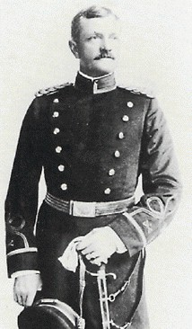
American Foreign Policy Expands (continued)
John J. Pershing wrote:
"White regiments and black regiments fought shoulder to shoulder, unmindful of race or color and mindful only of their common duty as Americans."

Slide 13
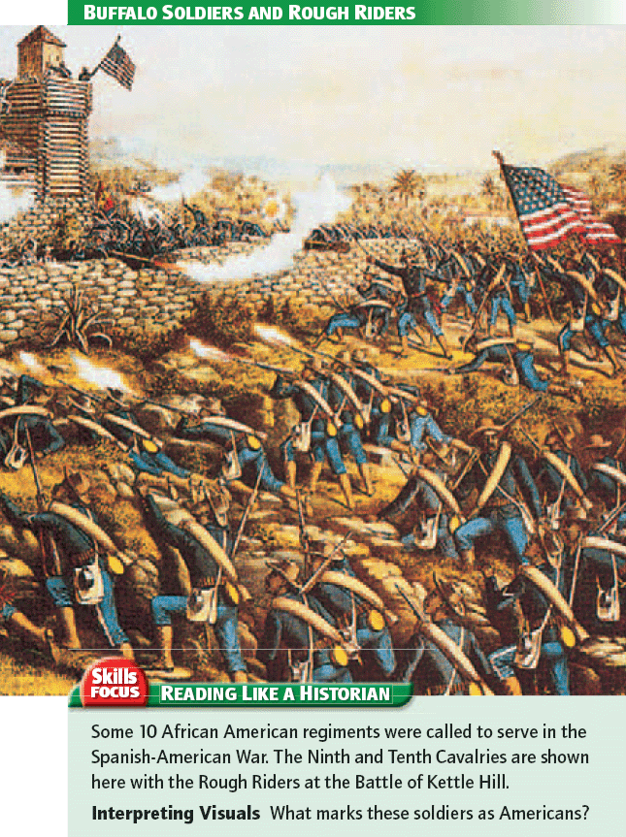

Slide 14
American Foreign Policy Expands (continued)
The Spanish fleet attempted to escape on July 3
US fleet sank or forced the beaching of every one of them
The city of Santiago surrendered on July 17
Puerto Rico—July 25 the US began an invasion to liberate that island—met almost no opposition
Philippines—Several contingents of U.S. troops arrived in the Philippines in August entered and occupied Manila—Filipino revolutionaries resisted American control after the Spanish were defeated

Slide 15
American Foreign Policy Expands (continued)
Results of the war
The peace treaty
Some thought the United States was wrong to keep the spoils of war, except for Cuba
Treaty of Paris, Dec. 10, 1898
Spain granted Cuba its freedom
Spain ceded Guam, Puerto Rico, and the Philippines to the United States
The United States, in turn, paid Spain $20 million for the Philippine Islands
Anti-imperialism
Many people in the United States did not like their nation's new position as a colonial power--anti-imperialists
They did not wish to hold subject peoples by force, run the risk of becoming involved in further wars, or face competition from colonial products or workers
Their forces were so strong in the Senate that it ratified the peace treaty by only one vote on Feb. 6, 1899

Slide 16
American Foreign Policy Expands (continued)
Foreign Policy Changes
The United States had to put down a long and bloody insurrection in the Philippines
US needed to strengthen its defenses, build more powerful battleships, and reorganize the army to remedy serious weaknesses revealed by the war
The war showed the need for a canal through the Isthmus of Panama, which separated the Caribbean Sea from the Pacific Ocean
New Leadership and Direction for the Nation
The war brought new faces to the front in politics (Theodore Roosevelt) and the Military (John J. Pershing)
America enters the global economy full force
America asserts itself as a legitimate international power
American people reject the concept of “conquering an empire”—favor international trade

Slide 17
America Becomes a World Power
President William McKinley set up a military government in Cuba.
U.S.-appointed Governor of Cuba Leonard Wood oversaw the drafting of a new Cuban Constitution in 1901.
Platt Amendment—limited Cuba’s ability to sign treaties with other nations
gave the U.S. the right to intervene in Cuban affairs and set up military bases.—U.S. naval base at Guantanamo Bay.
made Cuba a U.S. protectorate – a country under the control and protection of another country.

Slide 18
America Becomes a World Power (Continued)
President McKinley also set up a military government on Puerto Rico as a territory.
Foraker Act of 1900 established that the U.S. would appoint a governor and upper house of legislature. Puerto Rican voters elected the lower house.
A 1917 law granted Puerto Ricans U.S. citizenship and ability to elect all legislative representatives.
In 1952, Puerto Rico became a self-governing commonwealth, with power over most of its domestic affairs.
The U.S. still controls interstate trade, immigration, and military affairs.

Slide 19
America Becomes a World Power (Continued)
The Philippines resisted US control after the war
Emilio Aguinaldo led the resistance against his former allies—felt betrayed by “protectorate status” for his country
Resistance ended and order was restored by US military—pockets of guerilla fighters continued for decades
Economy improved under the leadership of William Howard Taft—appointed governor over the islands—improved life for people weakened resistance to US control

Slide 20
America Becomes a World Power (Continued)
The Panama Canal
The United States bought the rights to build the canal from the French in 1902.
Panama was a part of the Republic of Colombia.
Columbian officials initially agreed to allow the US to start the canal—then, started demanding more money—didn’t believe US could do anything
Revolutionaries were plotting to break free of Colombian rule
President Theodore Roosevelt supported the revolution
Roosevelt sent the Atlantic Fleet to blockade Panama and landed Marines
US recognized the new government, the Republic of Panama.
A new treaty with Panama gave the United States complete control of the 10-mile-wide Canal Zone.
American work began in May 1904.
August 1914 the SS Ancon became the first ship to pass through the canal.

Slide 21
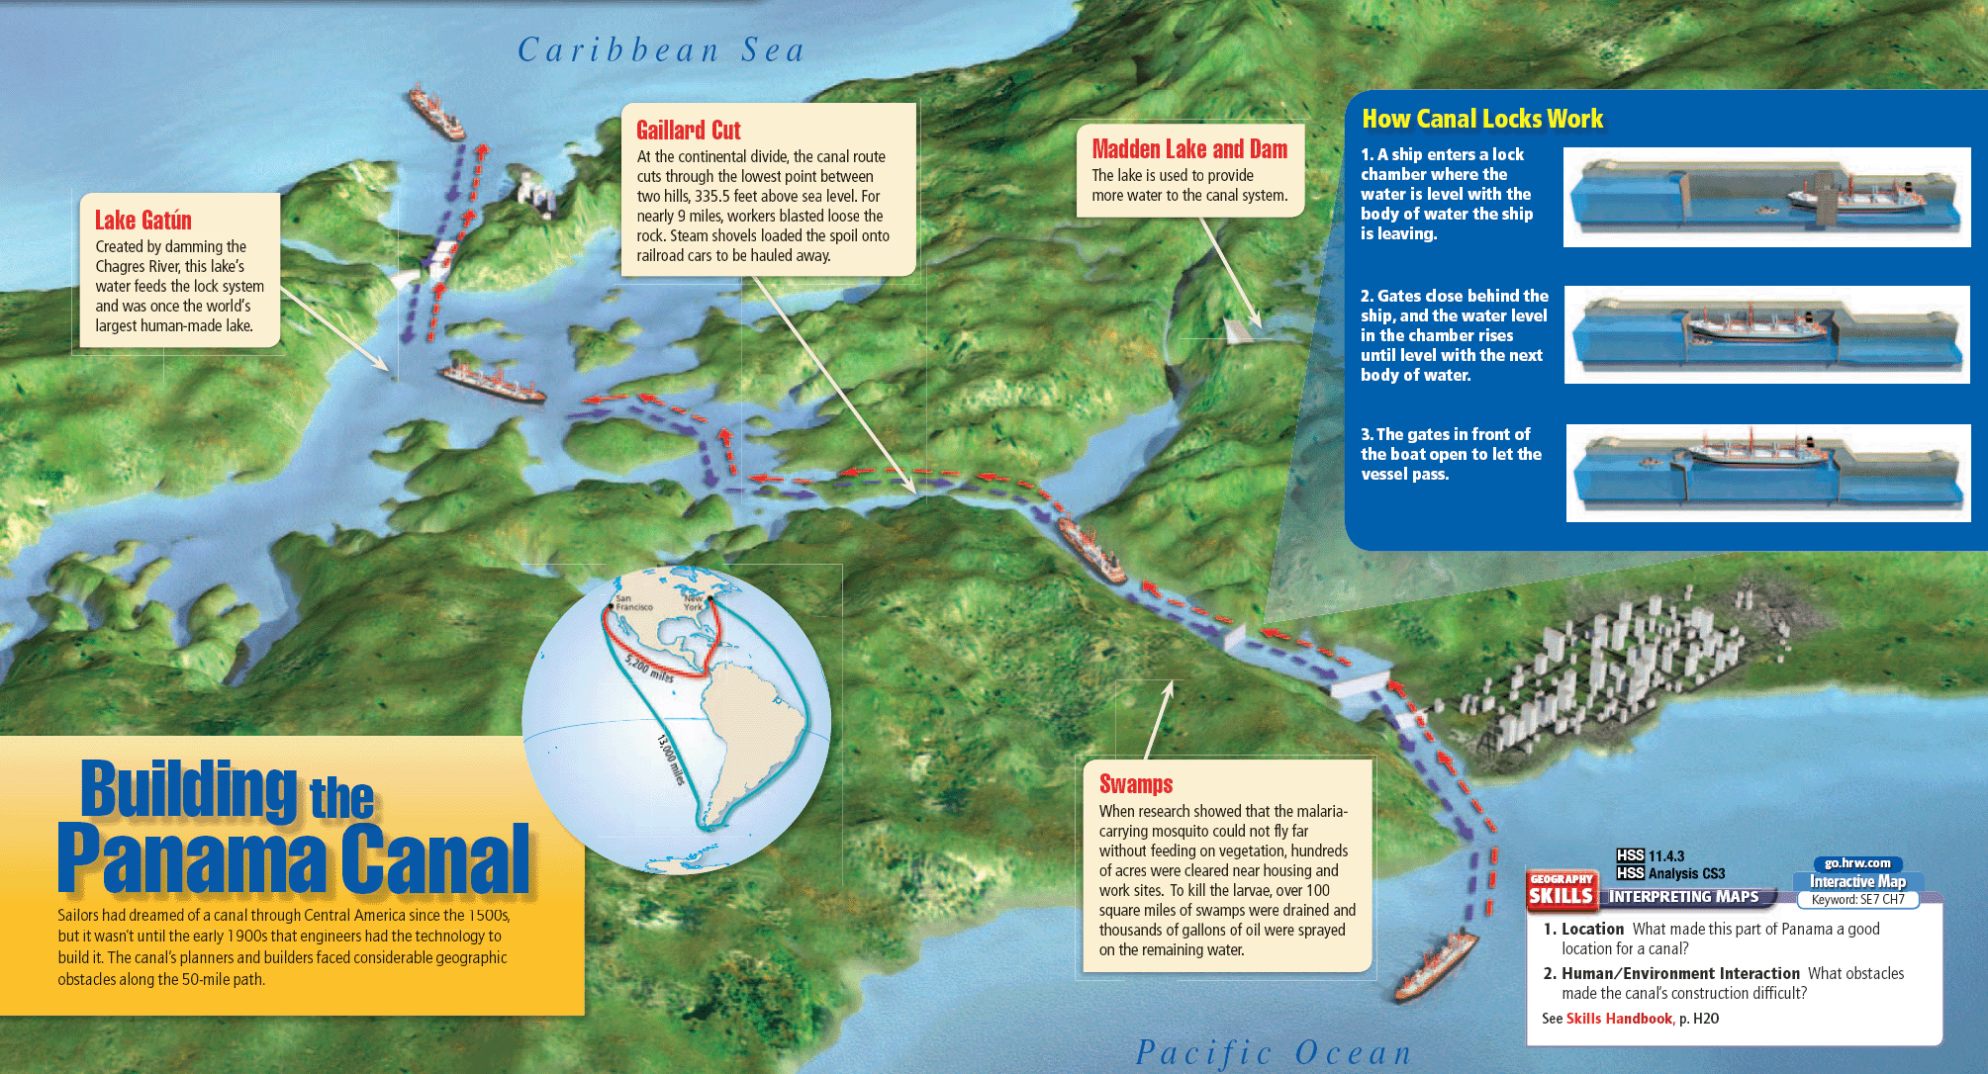

Slide 22
America Becomes a World Power (Continued)
Big Stick Diplomacy—“Speak softly but carry a big stick”
Roosevelt believed that the threat of military force was essential to solve things diplomatically
US built up and improved military technology without any plans for expansion or conquest
Made the US a legitimate nation to the rest of the world
Roosevelt helped broker peace treaties in Europe and Asia—won the Nobel Peace Prize

Slide 23
America Becomes a World Power (Continued)
After the Spanish-American War, presidents backed up the Monroe Doctrine with military strength.
1904—Dominican Republic could not pay back European lenders—Germany threatened invasion
To prevent Europeans from using force, Roosevelt issued the Roosevelt Corollary:
The United States pledged to use force to prevent European countries from seizing Dominican territory.
The United States took control of collecting Dominican customs duties.
Set a precedent of the US intervening on behalf of another nation in the W. Hem.
Succeeded in bringing more stability to the region.
Sailing of the Great White Fleet—Showed American Naval Power

Slide 24
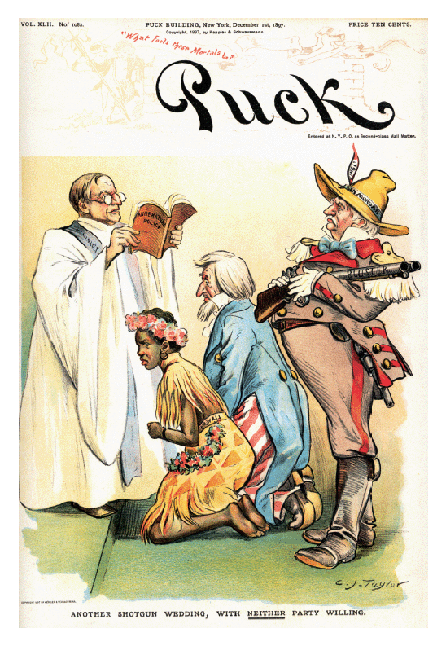

Slide 25
America Becomes a World Power (Continued)
Taft’s “Dollar Diplomacy”
President William H. Taft promoted advancing U.S. interests abroad by promoting American economic interests
Taft believed in using US economic power to achieve American goals.

Slide 26
America Becomes a World Power (Continued)
Uprisings occurred in various parts of Mexico as a result of election conflicts and the tactics of President Diaz
Led to open revolution and border hostilities in 1911
November 1911, Madero was elected president of Mexico—tried to establish democracy
Madero’s government was overthrown by General Victoriano Huerta, in 1913—military coup
Four armies then rose up against Huerta, continuing the instability in the region.
Venustiano Carranza declared himself leader in August 1914, and was supported by President Wilson.

Slide 27
America Becomes a World Power (Continued)
Zapata and Pancho Villa opposed Carranza—Villa led hundreds of troops to New Mexico—17 Americans were killed—first armed invasion of the continental United States since the War of 1812.
President Wilson ordered General John J. Pershing to lead more than 10,000 troops into Mexico to search for Villa—were not able to find him.
Relations between Mexico and the United States were strained.
Fighting in Mexico continued until 1920
Many Mexicans immigrated to the United States in search of a more stable life.

Slide 28
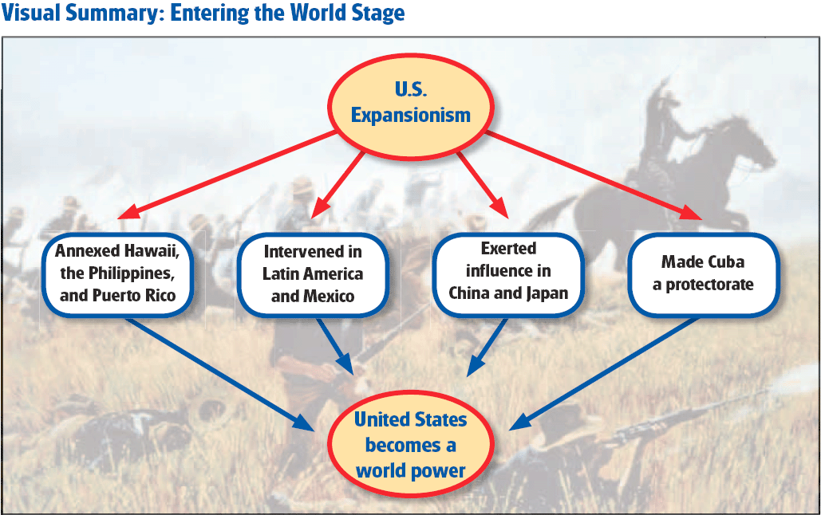

Slide 29
The First World War
1914-1920
Chp. 8

Slide 30
The First World War—1914-1918 Background to the war
The rise of nationalism—the belief that loyalty to a person's nation and its political and economic goals comes before any other public loyalty
increased the possibility of war because a nation's goals could conflict with the goals of one or more other nations
caused nations to magnify small disputes into major issues—increased threat of war
took hold among people who shared a common language, history, or culture
led to the creation of two new powers—Italy and Germany
gained enthusiastic support as Western Europe granted the vote to more people
weakened the eastern European empires of Austria-Hungary, Russia, and the Ottomans
national groups that clamored for independence
especially explosive in the Balkans—the states on the Balkan Peninsula in southeastern Europe
Serbia led a movement to unite the Balkan Slavs
1908—Austria-Hungary greatly angered Russia and Serbia by adding the Balkan territory of Bosnia-Herzegovina to its empire

Slide 31
The First World War—1914-1918 Background to the war
build-up of military might occurred among European countries before World War I broke out
quick victories achieved by the Germans in their wars of unification made the German army a model for others
military draft helped create a sense of nationalism
general staff—task in peacetime was to plan for the army’s use in war
United Kingdom relied on its navy for defense—and it had the world's strongest navy
1898—Germany began to develop a naval force big enough to challenge the British navy
1906—the British launched the Dreadnought, the first modern battleship—Germany rushed to construct ships like it—arms race
technology—increased the destructive power of military forces—enabled countries to fight longer wars and bear greater losses than ever before

Slide 32
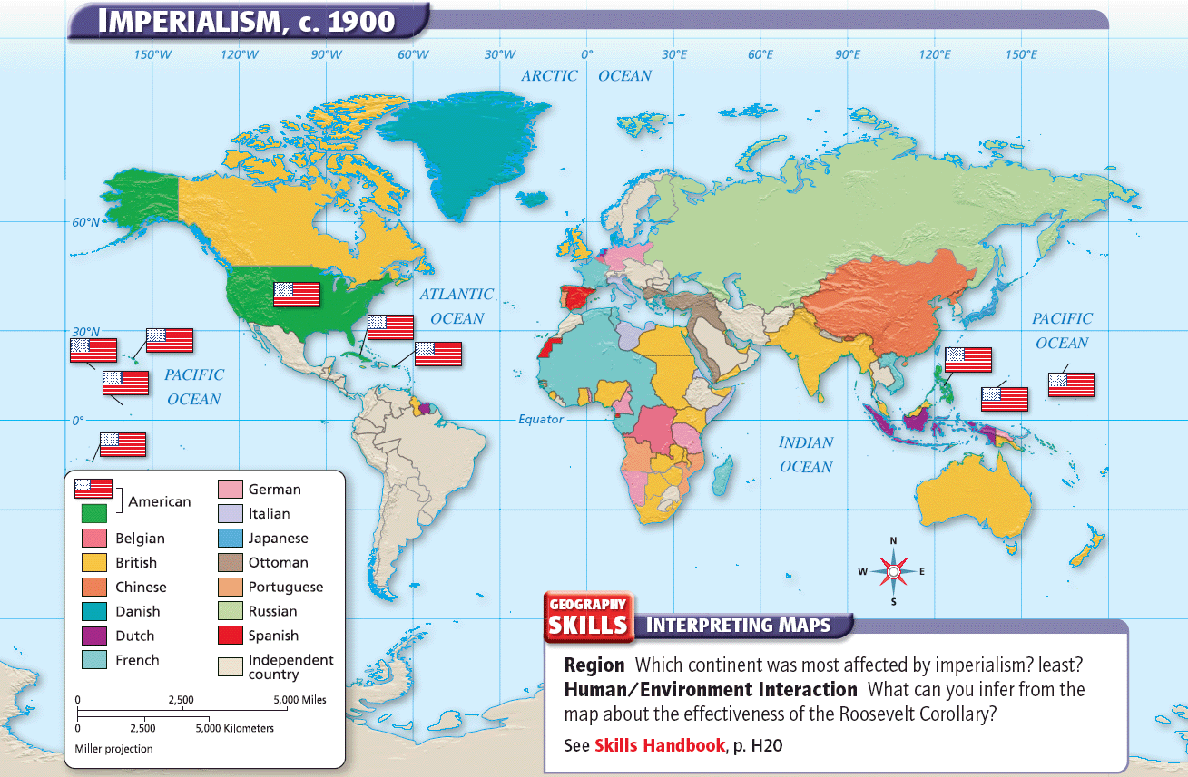

Slide 33
The First World War—1914-1918 Background to the war
Competition for colonies
European nations carved nearly all of Africa and much of Asia into colonies
race for colonies was fueled by Europe's increasing industrialization
Colonies supplied European nations with raw materials for factories, markets for manufactured goods, and opportunities for investment
strained relations among European countries

Slide 34
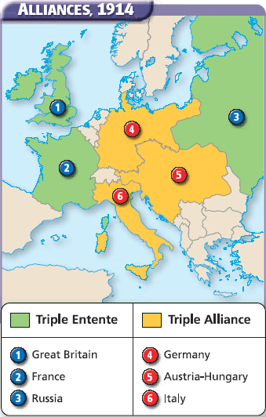

Slide 35
The First World War—1914-1918 Background to the war
military alliances
gave European powers a sense of security before World War I
discourage an attack from enemies by entering into a military agreement with one or more other countries
guaranteed that other members of the alliance would come to the country's aid or at least remain neutral
country might take risks in dealings with other nations that it would hesitate to take alone
alliance system meant that a number of nations would fight, not only the two involved in a dispute
Alliances could force a country to go to war against a nation it had no quarrel with or over an issue it had no interest in
terms of many alliances were kept secret—increased the chances that a country might guess wrong about the consequences of its actions
assassination of Archduke Franz Ferdinand triggered World War I—direct result of all these factors

Slide 36
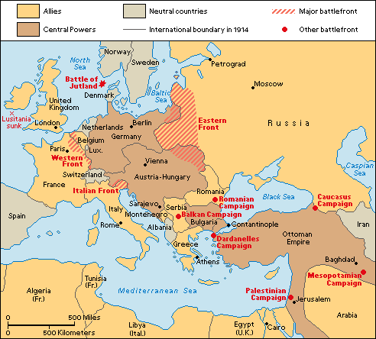
The First World War—1914-1918 Background to the war

Slide 37
The First World War—1914-1918 America in WWI
Initial German assault pushed deeply into Belgium and France
British forces made large gains in the Middle East—Lawrence of Arabia
By 1915 fronts had stabilized and produced a tense “stalemate” both East and West
Hardships in Russia led to political upheaval and eventually to revolution

Slide 38
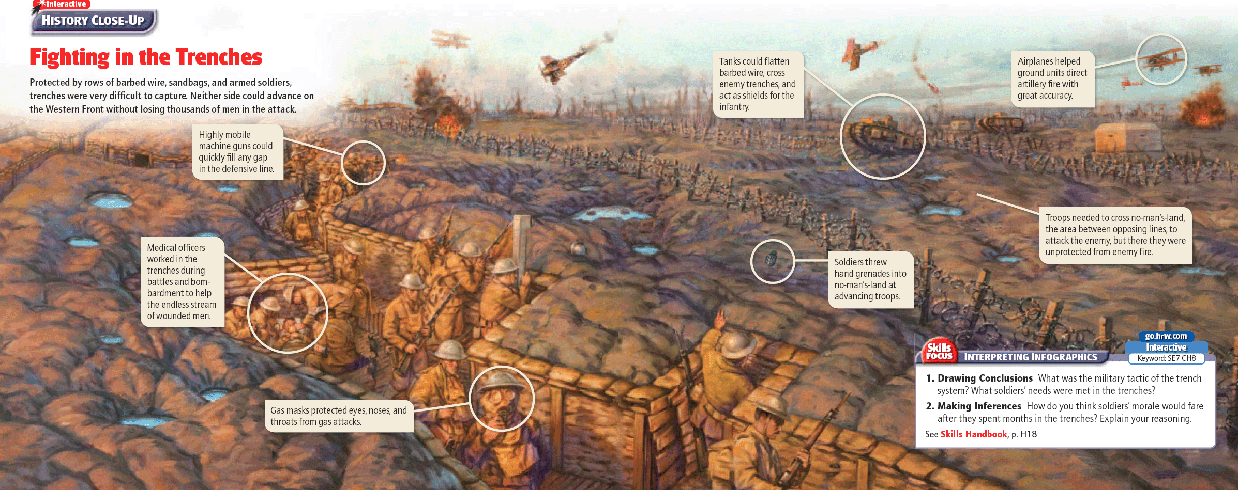

Slide 39
The First World War—1914-1918 America in WWI
“He kept us Out of War!”—Slogan for Wilson’s re-election in 1916
1914-1917—US official position was neutrality
German acts of aggression brought America closer to joining the Allies
May 7, 1915—Germans sank the HMS Lusitainia
-killed 1,201 people, including 128 American passengers
-ship was smuggling supplies and munitions to the Allies
-US protested the killing of innocent civilians
-Germany agreed to stop such attacks
January 1917—The Zimmermann Note was intercepted
-telegram intercepted by the British
-revealed a German plot to persuade Mexico to go to war with the US
-story was leaked to American newspapers
-turned public opinion against Germany
February 1917—German subs began sinking American merchant ships
US declared war on the Central Powers on April 6, 1917

Slide 40
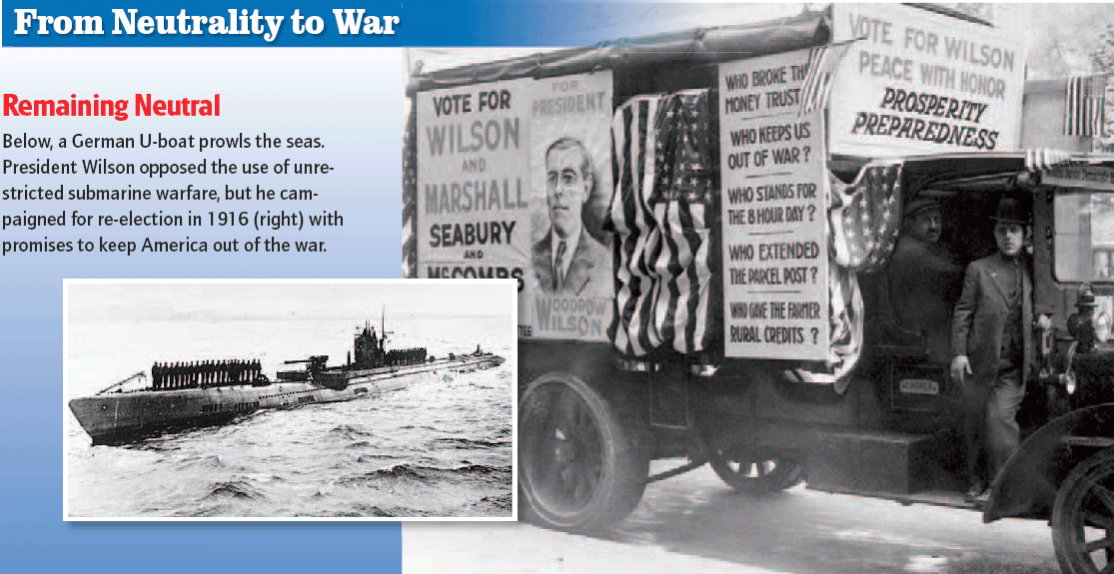

Slide 41
The First World War—1914-1918 American Troops in Europe
American Expeditionary Forces (A.E.F.)
General John J. Pershing, commander
Arrived in France in mid-June 1917—a few thousand soldiers
By August 1918—about 1 million U.S. troops in Europe
By November 1918—about 2 million American soldiers in Europe
November 1917—Allies formed the Supreme War Council to plan strategy
Defensive strategy until enough U.S. troops could reach Western Front
Allies wanted Americans to serve as replacements
Pershing wanted the A.E.F. to remain independent
Believed his troops would be weakened if they were dispersed among the European forces
Pershing generally held firm, though at times he lent troops to France and the United Kingdom

Slide 42
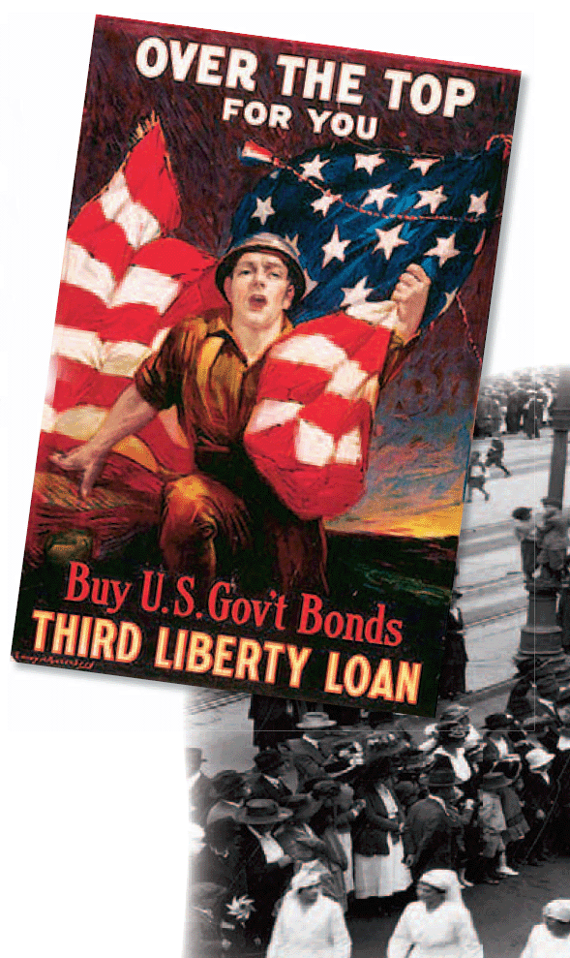

Slide 43
The First World War—1914-1918 The Last Campaigns
Collapse of Russia enabled the Germans to concentrate on Western Front
Hoped to secure victory before the Americans could reach the front
Spread too thinly on five offensives in the spring and summer of 1918
A second German offensive—April 9-April 30
The Allies suffered heavy losses in both assaults
German casualties were just as great
Germany attacked a third time on May 27 near the Aisne River
By May 30, German troops had reached the Marne River
American soldiers helped France stop the German advance at Chateau-Thierry, less than 50 miles northeast of Paris
In June, a fourth German offensive against Allied troops near Compiegne gained little ground

Slide 44
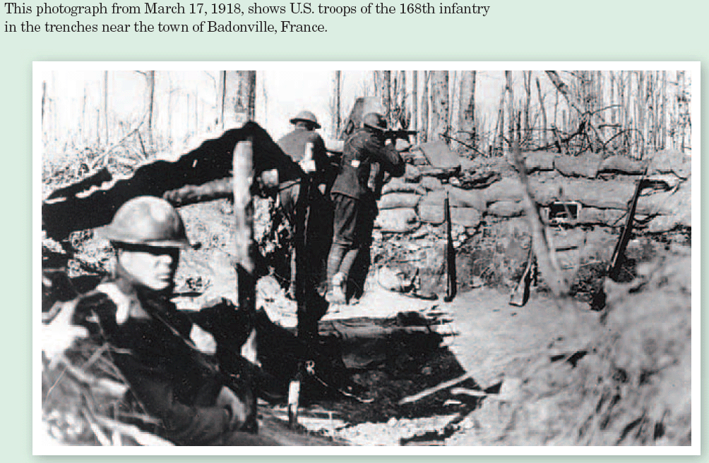

Slide 45
The First World War—1914-1918 The Last Campaigns
U.S. troops drove the Germans out of Belleau Wood, a forested area near the Marne
July 15, the Germans launched their fifth and final offensive across the Marne.
French counterattack near the town of Soissons on July 18.
It marked the turning point of World War I.
The Allies won the battle and began a steady advance.
On August 8, the United Kingdom and France attacked the Germans near Amiens.

Slide 46
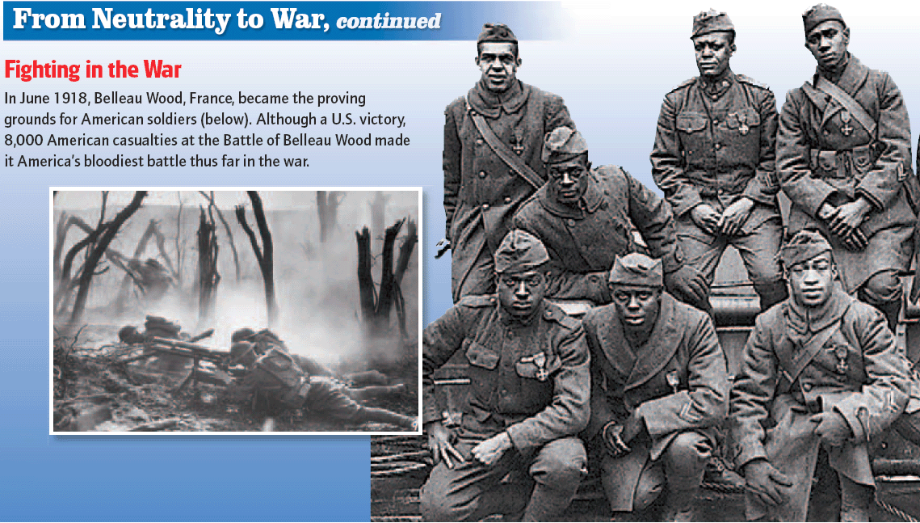

Slide 47
The First World War—1914-1918 The Last Campaigns
By early September, Germany had lost all the territory it had gained since spring.
In mid-September, Pershing led U.S. forces to an easy victory at St.-Mihiel.
Sept. 26, 1918, the Allies began attacks along the length of the Western Front
About 900,000 U.S. troops participated in heavy fighting between the Argonne Forest and the Meuse River.

Slide 48
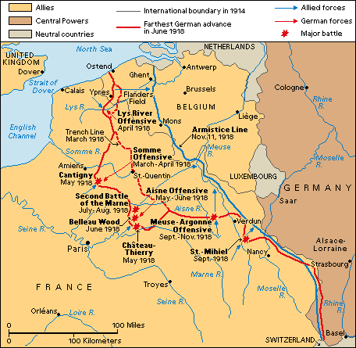
The First World War—1914-1918 American Troops in WWI

Slide 49
The First World War—1914-1918 The Fighting Ends—The Armistice
Armistice: a temporary suspension of hostilities by agreement of the warring parties; truce
The Allies won victories on all fronts in the fall of 1918.
Bulgaria surrendered on September 29.
On October 30, the Ottoman Empire signed an armistice.
Austria-Hungary signed an armistice on November 3.
Germany demanded an armistice at the end of September, but negotiations over the terms continued throughout October.

Slide 50
The First World War—1914-1918 The Fighting Ends—The Armistice
Germans suffered food shortages
Strikes and riots turned into revolution, and mutiny broke out in the fleet.
Kaiser Wilhelm gave up his throne on November 9 and fled to the Netherlands.
In the early morning on Nov. 11, 1918, the Germans accepted the armistice terms demanded by the Allies.
Evacuate the territories it had taken during the war
Surrender large numbers of arms, ships, and other war materials
Allow the Allied powers to occupy German territory along the Rhine River.
French Field Marshall Foch ordered the fighting to stop on the Western Front at 11 a.m. World War I was over.

Slide 51
The First World War—1914-1918 Treaty of Versailles
The Big Four
President Woodrow Wilson of the United States
Prime Minister David Lloyd George of Britain
Premier Georges Clemenceau of France
Prime Minister Vittorio Orlando of Italy
Italy and France led the push for revenge in the negotiations
Wanted the Central powers to pay reparations for the war
Wanted to seize territory from the Central Powers
Great Britain and the US worked for stability
Britain wanted Germany to keep economics intact-limit military ability
Wilson worked for a more democratic Europe
14 Points for Peace—Wilson’s vision of Post WWI Europe
Worked for self-determination for the ethnic groups of Europe
Wanted to establish a League of Nations and a World Court to settle international disputes
Had to compromise on reparations and boundaries to get his main ideas included in the treaty

Slide 52
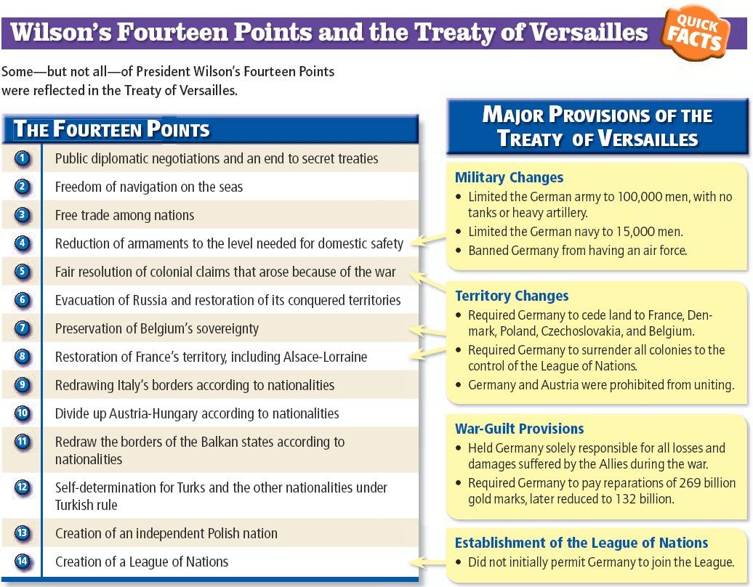

Slide 53
The First World War—1914-1918 Terms of Treaty of Versailles
Borders were redrawn
Italy received the South Tyrol region of Austria-Hungary
Japan obtained German colonies in the North Pacific Ocean and German holdings in China's Shantung province
Germany lost all its overseas colonies
Germany lost:
the provinces of Alsace and Lorraine to France
Eupen, Malmedy, Moresnet, and St. Vith to Belgium
border area to Czechoslovakia
Northern Schleswig to Denmark
Danzig came under protection of the League of Nations
Poland got most of West Prussia and much of the province of Posen

Slide 54
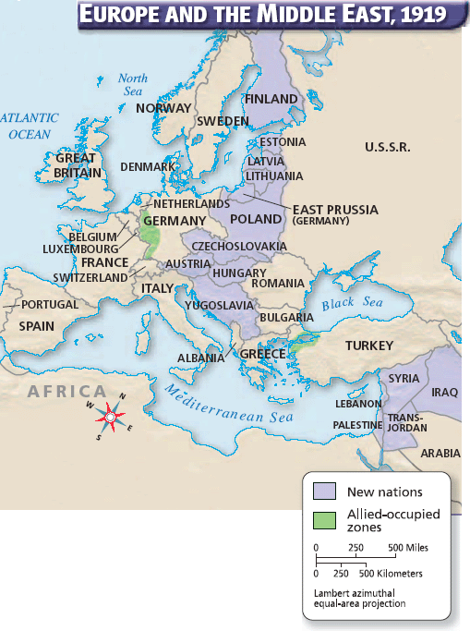

Slide 55
The First World War—1914-1918 Terms of Treaty of Versailles
Wilson also compromised on reparations- more than Germany could afford
had to give the Allies coal, livestock, ships, timber, and other resources
cash payments
possession of the coal mines in Germany's Saar region for 15 years
Rhineland was occupied by the Allies for 15 years
Established a League of Nations and a World Court to settle international disputes
Reorganized boundaries/territories of European nations/areas they controlled in Africa, Asia, and Pacific
It provided a system for administering the former colonies of the defeated countries
It took effect early in 1920
The US and China refused to sign it—League of Nations

Slide 56
The First World War—1914-1918 Effects of the Treaty of Versailles
Germany
Lost land and huge reparations greatly angered many Germans
bitter about a "war guilt" clause in the treaty that declared Germany solely responsible for the war
These factors contributed to the rise of German dictator Adolf Hitler and his Nazi Party during the 1930's.
New political ideologies filled the power void in Europe in the 1920’s/30’s—Fascism and Communism
Devastated Economies and Populations of Europe

Slide 57
The First World War—1914-1918 Effects of the Treaty of Versailles
League of Nations
association of countries created to maintain peace among the nations of the world
Britain, France, Italy, Japan, and the United States—drew up a covenant (constitution) for the league in 1919
President Woodrow Wilson of the United States was the chief planner of the league of nations:
Believed that world wars would continue to occur as long as each nation was responsible for its own defense. Wanted the nations of the world to join together in the League of Nations Pledge to defend the territory and independence of any member attacked by another nation Believed that even a powerful nation, knowing it would face the united opposition of all other powerful nations, would not go to war. | Got other countries to agree to his plans for the League He and members of the U.S. Senate differed over the terms on which the United States would join March 1920, the U.S. Senate rejected the Treaty of Versailles—REVENGE factor of the treaty was too strong Americans decided there was no need to concern themselves with conflicts overseas, and the United States never did join the League of Nations.

Slide 58
The First World War—1914-1918 Effects of the Treaty of Versailles
The League was established in January 1920, in Geneva, Switzerland
Largely ineffective as a peace-keeping body—lack of international acceptance and no real power
The organization ceased to function after World War II began in 1939
Formally dissolved in April 1946, and the United Nations took its place

