Slide 1
America in World War II
Chp. 13-14

Slide 2
German Forces Turn to the West
On September 3, 1939, Great Britain and France declared war on Germany. They became known as the Allies.
The Allies did not attack Germany. Instead, they decided to wait for Germany to make its next move. They believed that Germany’s army would grow weak trying to invade France.
Germany made plans to invade France through the Ardennes Forest. This was rugged terrain and the French army concentrated their defenses elsewhere. For example, the famed Maginot Line was to the south of the Ardennes.

Slide 3
The Blitzkrieg of Western Europe
April 1940 Hitler invaded Denmark and Norway.
This improved Germany’s access to the Atlantic.
Both countries fell with little resistance.
May 1940 Germans invaded France.
Germans conquered the Netherlands and stormed into Belgium.
Belgian, British, and French troops tried to stop the Germans in Belgium.
By early June the Germans had trapped hundreds of thousands of Allied soldiers at the French port of Dunkirk.
Meanwhile, German forces attacked France through the Ardennes. The Maginot Line had been bypassed.
June 1940 France surrendered to Germany and Italy.
The unoccupied part of France was known as Vichy France.
Many French leaders, including Charles de Gaulle, fled to Great Britain to organize resistance to German and Vichy control of France.

Slide 4
Increasing Tensions in East Asia
1934 Japan began expanding its naval forces despite promises made at the Washington Naval Conference.
1936 Japan signed an anticommunism pact with Germany.
1937 Japan began a war against China.
1940 Japan formed a military alliance with Germany and Italy. These nations were known as the Axis Powers.
1941 Japan moved to take control of French Indochina, which threatened American interests. President Roosevelt
tried to reason with General Hideki Tojo, the minister
of war who took control of the country in October of
1941. But the time for compromise was over.

Slide 5
The United States Enters the War
The Main Idea
Isolationist feeling in the United States was strong in the 1930s, but Axis aggression eventually destroyed it, pushed the United States into war and spurred the mobilization of American military and industrial might.
Reading Focus
Why was a commitment to isolationism so widespread in the 1930s?
How did Roosevelt balance American isolationism with the need to intervene in the war?
What did the United States do to prepare for war in 1940 and 1941?
What were the causes and effects of the Japanese attack at Pearl Harbor?
How did the U.S. armed forces mobilize to fight World War II?
What role did American industry and science play in mobilizing to fight World War II?
How did mobilization challenge the nation’s ideals of freedom?

Slide 6
United States Isolationism in the 1930s
The desire to avoid involvement in foreign wars was known as isolationism. Isolationists were not necessarily pacifists. Most isolationists simply wanted to preserve America’s freedom to choose the time and place for action.
Many Americans questioned what the Allies’ costly victory in World War I had actually achieved. Anti-League of Nation feelings soared as people believed that the League might drag the United States into future wars.
Roosevelt was not an isolationist; however, he was focused on solving problems at home by implementing his New Deal programs. Congress did pass isolationist measures such as the Neutrality Act in 1935.

Slide 7
Isolationism versus Intervention
Isolationism
The Neutrality Act prohibited the sale of arms or making loans to warring countries.
Roosevelt needed the support of isolationists in Congress. They wanted to remain neutral.
The United States did not intervene in the Spanish Civil War or the Japanese invasion of China.
Intervention
When Italy invaded Ethiopia, Roosevelt stopped arms sales to both countries—which hurt only Italy.
Roosevelt did not want to remain neutral—he was worried about the aggressive actions of totalitarian leaders.
Roosevelt began to speak out against neutrality with his Quarantine Speech.

Slide 8
The United States Prepares for War
Roosevelt asked Congress for money to build new naval vessels.
Congress approved despite isolationist complaints.
Congress changed the neutrality laws to a new policy called cash-and-carry.
Countries at war could buy American goods if they paid cash and picked up their goods at American ports.
Roosevelt urged a policy of “all aid short of war.”
He traded 50 aging warships for eight British military bases. Isolationists opposed the deal, but were too weak to stop it.

Slide 9
Preparing for War
Roosevelt defeated business leader Wendell Willkie for an unprecedented third term as president. He felt world events required experience in the White House.
Roosevelt wanted to make the United States an “arsenal of democracy.” Congress passed the Lend-Lease Act, which allowed the nation to send weapons to Great Britain.
Roosevelt and Winston Churchill met secretly in 1941. They agreed to the Atlantic Charter. This document proclaimed the shared goals of the United States and Britain in opposing Hitler and his Allies.
Despite German U-boat attacks on U.S. ships trying to deliver goods under the Lend-Lease Act, isolationists continued to oppose entry into the war.

Slide 10
Attack on Pearl Harbor
Causes
Conflict over French Indochina
Japan allied with Germany & Italy
Prime Minister Hideki Tojo was hostile toward the US—competition in the Pacific
Effects
Americans reacted with anger and fear.
Some feared Japanese Americans would assist an invasion—Internment Camps
The US declared war on Japan (12-8-1941)
Germany and Italy declared war on the US—Axis Alliance

Slide 11
The Attack on Pearl Harbor
Defenses
US intelligence believed an attack was possible
Defense forces were unprepared
No commander in charge—Multiple
Routine defensive steps were not in place
The Attack
Sunrise, December 7, 1941
Aircraft carriers approached Oahu
War planes destroyed US ships and planes on Oahu
The attack lasted 2 hours.
The Aftermath
All 8 battleships damaged-4 sunk
200 aircraft destroyed
2,400 Americans killed
Japan lost a few submarines 30 planes

Slide 12
U.S. Armed Forces Mobilize
US had to mobilize—bring its forces into readiness
1940 the government increase in military spending
This helped end the Great Depression
Thousands found work making supplies for the military
Army Chief of Staff, George C. Marshall led mobilization
US needed soldiers—draft and recruitment
Women filled a variety of vital roles in the military
New military bases needed to train and house soldiers

Slide 13
Mobilizing the Armed Forces
Finding Soldiers
Expanded the draft
Millions volunteered
16 million entered the armed forces
Women at War
10,000 joined the WAVES-Navy
1,000 joined the WASPs-Air Corps
150,000 joined the WAC-Army
Colonel Oveta Culp Hobby led the WAC’s
Military Bases
Most were in rural areas
Bases transformed parts of the US— boost to economy
CA, FL, and TX had several bases

Slide 14
American Industry and Science in WW II
Troops needed equipment
Factories were converted to make military supplies
Roosevelt called for improved military technology
War supplies had to be shipped
Submarines attacked US shipping
US shipyards built thousands of new vessels
Henry Kaiser built liberty ships using assembly-line techniques
Wartime agencies regulated factories, prices, and raw materials
Production required many workers and created jobs
Technology played an important role in World War II

Slide 15
Mobilizing Industry and Science
Factories needed workers but men were leaving for war
Women worked outside the home in industrial jobs.
Represented by symbol known as Rosie the Riveter
Rosie the
Riveter
Government was concerned about strikes
National War Labor Board helped settle labor disputes
Smith-Connally Act (1943)—Presidential power to take over vital war industries
Labor in
WW II
Manhattan Project—top-secret mission to build an atomic bomb.
J. Robert Oppenheimer and other scientists raced to develop weapon ahead of Germans
Mobilizing
Science

Slide 16
The War in Europe and North Africa
The Main Idea
After entering World War II, the United States focused first on the war in Europe.
Reading Focus
How and why did the Allies fight the Battle of the Atlantic?
What were the key events of the war in the Soviet Union?
What did American forces accomplish in North Africa and Italy?
What were the events and significance of the Allies’ D-Day invasion of France?

Slide 17
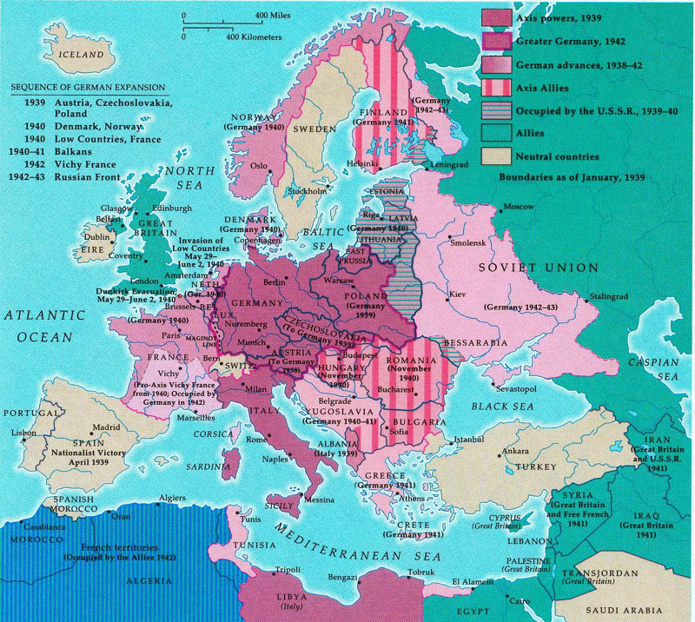
The European Theatre

Slide 18
Fighting the Battle of the Atlantic
Defeating the Axis Powers depended on control of the seas.
The Atlantic needed to be kept safe for shipping
Soldiers and goods could be transported from the United States to the other Allied nations.
Germany had a very powerful navy including with new surface ships (including the giant Bismarck) and U-boats.
German used new tactics to increase U-boat effectiveness such as the so-called wolf pack.
U-boats sent hundreds of ships and tons of supplies to the bottom of the sea.
At the same time, the German navy lost few of their boats.
The entry of the United States into the war would help turn the tide in the Battle of the Atlantic.

Slide 19
Allied Victory in the Atlantic
Allied ships and aircraft
American shipyards began producing new ships at an amazing rate.
The new ships were used to form larger, better-equipped convoys, which cut down on the effectiveness of U-boat attacks.
Allied aircraft protected convoys from the air.
2. Cracking the Enigma
The Allies broke the German code system, which was called the Enigma.
The Allies began to gain vital information about the locations and plans of U-boat formations.
Finally, the Allies had an advantage over the Germans.

Slide 20
World War II in the Soviet Union
Hitler broke his nonaggression pack with Stalin and invaded the Soviet Union in 1941.
Soviets then joined the Allies as enemies of the Axis Powers.
Soviets were unable to stop the German blitzkrieg; but, a bitterly cold Russian winter proved a great ally in driving back the Nazis
Germans held a vast portion of the western Soviet Union and besieged the city of Leningrad.
The Germans attacked Stalingrad in August 1942.—Soviets refused to let Stalingrad fall, and Hitler suffered a stunning defeat in early 1943.
Stalingrad marked the beginning of Germany’s collapse in the Soviet Union.—Soviet forces pushed Germany out of Russia, but lost 12 million soldiers and millions of civilians.

Slide 21
North Africa and Italy
Why was North Africa important?
By controlling North Africa, the British could protect shipping on the Mediterranean Sea.
They needed the ability to ship oil from the Middle East through the Suez Canal.
2. What was the result of fighting in North Africa?
Italy could not drive the British from Egypt.
Hitler sent troops under the direction of Erwin Rommel – “the Desert Fox”.
After a back-and-forth battle for North Africa, the Allied forces handed the Germans a major defeat at the battle of El Alamein.
3. What happened in Italy?
British and American forces invaded Italy in 1943.
The Italian people forced Mussolini from power, but Hitler rushed into Italy to stop the Allies.

Slide 22
The Invasion of France
To end the war as quickly as possible, the Allies planned Operation Overlord—a large invasion of mainland France.
2. The Allies landed at Normandy on June 6, 1944—called D-Day—and began to march on France.
3. The Battle of the Bulge became a symbol of American strength and determination.

Slide 23
D-Day
Operation Overlord
Planned invasion of France from the beaches of Normandy
General Omar Bradley led the American troops.
Good planning and speed were vital.
Americans were concerned about the V1 flying bomb and the V2 rocket.
2. D-Day
June 6, 1944
Allied force of 3.5 million soldiers
Germans were slow to respond
Estimated 10,000 Allied casualties, including 6,600 Americans
The Allies landed almost 1 million soldiers and 180,000 vehicles.
3. Battle of the Bulge
Surprise offensive by Germans
Key moment came at the Belgium city of Bastogne.
Lieutenant General George S. Patton provided relief for the soldiers at Bastogne.
Symbol of American strength and determination

Slide 24
The War in the Pacific
The Main Idea
After early defeats in the Pacific, the United States gained the upper hand and began to fight its way island by island to Japan.
Reading Focus
Why did the Allies experience a slow start in the Pacific?
How did the Allies bring about a shift in their fortunes in the Pacific?
What were the major events that marked Allied progress in the late stages of the Pacific war?

Slide 25
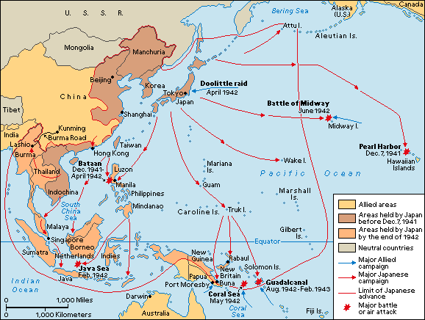
The Pacific Theatre of Operations—1941-42

Slide 26
A Slow Start in the Pacific
The attack on Pearl Harbor did significant damage to the U.S. Pacific Fleet and it took months to overcome the attack.
The Allies decided to focus their energy and resources on defeating the Axis in Europe.
The Japanese won a quick string of impressive victories following Pearl Harbor.
Drove American forces from Wake Island and Guam
Captured the British stronghold at Hong Kong
Took control of the Dutch East Indies (known as Indonesia today) and British Borneo
Damaged the Allied navies in the Battle of Java Sea
Conquered British-controlled Burma
The Japanese soldiers were highly skilled and well trained.
The Japanese military had excellent equipment.

Slide 27
The Philippines
Japan invaded the American-controlled islands of the Philippines in December 1941.
General Douglas MacArthur led the defense of the islands.
3. MacArthur’s troops were no match for the Japanese and he retreated to the Bataan Peninsula. Although he called for reinforcements, war planners decided sending ships was too risky.
4. In April 1942, the 10,000 American and 60,000 Filipino troops on Bataan surrendered.
5. Thousands of these captured soldiers died when the Japanese forced them to march through the steaming forests of Bataan. This became known as the Bataan Death March.

Slide 28
Allied Advances in the Pacific
James Doolittle
Army Lieutenant Colonel
Led a group of 16 American bombers on a daring air raid of Tokyo and several other Japanese cities
Doolittle’s raid did not do major damage to the Japanese targets, but it did give the American people something to celebrate and worried Japan’s leaders.
Fortunes Shift in the Pacific
Victory in the Battle of Coral Sea
Victory in the Battle of Midway

Slide 29
Allies Strike Back in the Pacific
Battle of Coral Sea
Japan prepared to invade New Guinea.
U.S. Admiral Chester Nimitz sent two aircraft carriers to stop the attack.
The Americans lost an aircraft carrier in the battle but stopped the Japanese attack.
First time the Japanese advance had been halted
Battle of Midway
Japan tried to lure the Americans into a large sea battle around Midway Island.
Naval officers had broken a Japanese code and learned of the plan.
Nimitz devised a plan to thwart the attack and placed his 3 aircraft carriers carefully.
The Americans destroyed 3 of the 4 Japanese carriers and won a major victory.

Slide 30
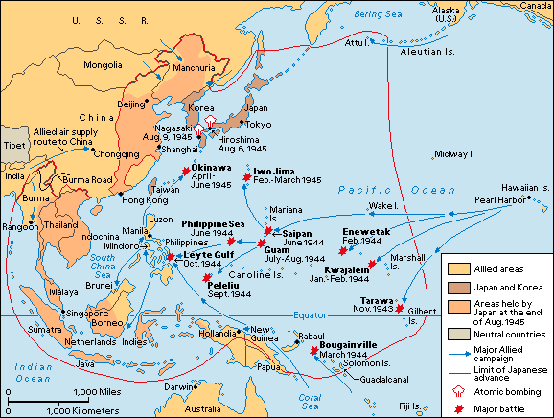
The Pacific Theatre of Operations—1943-45

Slide 31
Allied Progress in the Pacific
Gained control of territory in the Solomon Islands to protect Australia
Used powerful combination of land, sea, and air forces to capture key islands—Island Hopping
Captured locations in the Gilbert, Marshall, Caroline, and Mariana islands
American industrial power—replacing ships and aircrafts, which Japan was unable to do
European successes allowed more resources to be made available in the Pacific.
Recaptured the Philippines
Captured strategic Japanese islands of Iwo Jima and Okinawa

Slide 32
Keys to Allied Progress
Guadalcanal
Allies wanted the Solomons—protect Australia
Key island was Guadalcanal
Fighting lasted 6 months
US defeated the Japanese
Code Talkers
Native Americans served in the Marines as code talkers.
Translated messages into a coded version of their native language.
Japanese never figured it out.
The Philippines
Started with the Battle of Leyte Gulf.
Japan’s fleet was destroyed
1st use of kamikaze attacks.
Allies gained control of the Philippines—MacArthur “returned”

Slide 33
Iwo Jima and Okinawa
Iwo Jima
February 1945 US forces attacked Iwo Jima.
Good base to launch raids on Japan.
1st Time Japan was defending Japanese land.
Japanese refused to surrender—heavy losses
Okinawa
Allies invaded April 1, 1945.
Launching pad for the final invasion of Japan.
12,000 Americans died
Japanese lost 110,000 troops.
Allies gained control of the island in June 1945.

Slide 34
World War II Ends
The Main Idea
While the Allies completed the defeat of the Axis Powers on the battlefield, Allied leaders were making plans for the postwar world.
Reading Focus
How did the Allies defeat Germany and win the war in Europe?
How did the Allies defeat Japan and win the war in the Pacific?
What challenges faced the United States after victory?

Slide 35
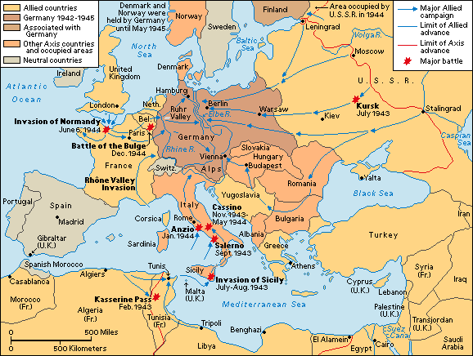
Europe at the End of WWII

Slide 36
Winning the War in Europe
After the Battle of the Bulge, Germany had few soldiers left to defend the homeland.
Germany faced 4 million Allied troops on its western border and millions more Soviet troops to the east.
The Big Three – Roosevelt, Winston Churchill, and Joseph Stalin – met in Yalta to make plans for the end of the war and the peace that was to follow.
Allied forces made their way across the Rhine River, which was a key barrier to the center of Germany.
Roosevelt decided to leave Berlin to the Soviets.
In April of 1945 Hitler realized that the war was lost and committed suicide in his Berlin bunker.

Slide 37
The Yalta Conference
Allied leaders Roosevelt, Winston Churchill, and Joseph Stalin—the so-called Big Three—met in the resort town of Yalta in the Soviet Union to discuss the end of the war and the peace that was to follow.
A key goal was to determine what to do with Germany. The leaders agreed to divide the country into four sectors. The Americans, Soviets, British, and French would each occupy one of these sectors. Berlin was also divided into four sectors.
Another agreement had to do with the fate of Poland and other Eastern European countries now occupied by the Soviets. Stalin agreed to hold elections in these countries after the war. Churchill was skeptical that the elections would happen. Was Stalin looking to gain more territory?
Stalin also said that the Soviet Union would declare war on Japan three months after Germany was defeated.

Slide 38
The Invasion of Germany
Crossing the Rhine
Hitler ordered his troops to make a stand at the Rhine River.
Despite the fact that the Germans blew up many of the bridges across the Rhine to slow the Allies, they managed to cross at Remagen.
The decision to defend the river turned out to be one of Hitler’s military mistakes.
The Berlin Question
Some Allied leaders wanted to capture Berlin before the Soviets did.
Eisenhower decided not to try to get to Berlin before the Soviets—later regretted the decision.
He believed the battle for Berlin would be bloody.
Allied leaders (FDR & Stalin) had already agreed on how to divide Berlin.

Slide 39
Hitler’s Death
1. On April 30, 1945, Hitler realized that all hope for a German victory was lost. He committed suicide in his Berlin bunker.
2. Berlin surrendered on May 2, 1945. Karl Dönitz, who had taken over as Germany’s leader, agreed to a surrender on May 7, which would take place the following day.
3. In the United States, May 8 was proclaimed V-E Day—Victory in Europe Day.

Slide 40
The Pacific Theatre of Operations—1943-45

Slide 41
Winning the War in the Pacific
The costs of capturing Okinawa were high.
High rates of battle-related psychological casualties
Thousands suffered from battle fatigue and other disorders.
Many dreaded the possibility of invading the major islands of Japan.
General MacArthur and Admiral Nimitz developed plans for a massive invasion of Japan.
A new bombing tactic was used on Japanese cities, one designed to produce tremendous firestorms in the bombed area.
Some Japanese leaders began to see the need for peace and wanted to contact the Soviet Union.
President Harry S Truman decided to drop an atomic bomb on Japan.
Japan surrendered on August 15, 1945.

Slide 42
The Atomic Bomb
Harry S Truman became president when Roosevelt died. He had to decide whether the United States should use the Manhattan Project’s atomic bomb.
After consulting with his advisors, Truman decided to drop the bomb on a Japanese city. There would be no warning.
On August 6, 1945, the Enola Gay dropped its atomic bomb on the city of Hiroshima.
Despite the horror caused by the bomb, the Japanese did not surrender.
On August 9, the United States dropped an atomic bomb on Nagasaki. Even this did not bring an end to the war.
Finally, on August 15 – known from then on as V-J Day—the Japanese emperor Hirohito announced the end of the war.

Slide 43
Challenges after the War
1. United Nations
Representatives from 50 countries met to form a new organization, the United Nations.
The UN was meant to encourage cooperation among nations and to prevent wars.
2. Potsdam
Allied leaders met in Potsdam, Germany, to discuss the spread of communism and Soviet influence in the postwar world.
Truman hoped to get Stalin to live up to his promises from Yalta.
Stalin did not do this. This begins the Cold War
3. Rebuilding
MacArthur led efforts to help Japan rebuild its government and economy.
Seven Japanese leaders were tried for war crimes.
Rebuilding Europe caused tensions between the U.S and the Soviet Union.

Slide 44
The Home Front
The Main Idea
While millions of military men and women were serving in World War II, Americans on the home front were making contributions of their own.
Reading Focus
What sacrifices and struggles did Americans at home experience?
How did the U.S. government seek to win American support for the war?
What was Japanese internment?
How did World War II help expand the role of the government in the lives of the American people?

Slide 45
Sacrifice and Struggle for Americans at Home
Americans planted victory gardens.
The United States began rationing food items such as coffee, butter, sugar, and meat.
Metal, glass, rubber, and gasoline were scarce goods.
Americans held scrap drives to collect waste materials that might be used in the war effort.
Conserving
Food
and other
Goods
Investing
in
Victory
Americans bought millions of dollars worth of war bonds.
Over half of the population did their civic duty and bought war bonds.
Families dealt with the absence of loved ones by displaying a flag with a blue star.
Americans read news accounts of the war with great interest (Ernie Pyle – newspaper journalist).
Paying the
Personal
Price

Slide 46
American Support for the War
Roosevelt called on the nation to protect the “four freedoms” – freedom of speech, freedom of worship, freedom from want, and freedom from fear.
2. The Office of War Information spread propaganda, or information and ideas designed to promote a cause. Examples included posters encouraging people to join the armed forces or to save gasoline. The OWI also warned the public about the dangers they faced.
3. Hollywood made a series of patriotic films that featured soldiers and workers on the home front.
4. Sometimes the drive to influence public attitudes led to conflict. For example, the Barnette ruling argued that Americans could not be forced to salute the flag.

Slide 47
Japanese American Internment
Executive Order 9066
After Pearl Harbor, military officials began to investigate the Japanese American community for signs of spying or other illegal activity.
It was recommended that all people of Japanese background be removed from the West Coast.
Order 9066 established military zones and could force people to leave these zones.
Japanese Americans in California, Washington, Oregon, and Arizona were forced into internment camps.
Many lost their homes and businesses.
2. Japanese American Loyalty
While interned, Japanese Americans were forced to answer questions about their loyalty to the United States.
German and Italian Americans also faced restrictions.
Many young people from the camps joined the armed forces to prove their loyalty.
Not all Japanese Americans accepted their internment peacefully.
Some mounted legal challenges such as Korematsu v. United States.

Slide 48
Korematsu v. United States (1944)
The Supreme Court tried to find the right balance between the rights of Japanese Americans and wartime needs.
Fred Korematsu refused the executive order that relocated 110,000 Japanese Americans to internment camps.
Korematsu was born in Oakland, California, and was an American citizen.
He was arrested and then appealed his case to the Supreme Court.
The Supreme Court ruled against Korematsu stating that the relocation order was justified as a temporary wartime measure.
He continued to work for civil rights and had his conviction overturned in 1983.

Slide 49
New Roles for Federal Government
The Office of Price Administration placed limits on the prices businesses could charge for products and materials.
The War Production Board made sure the military got the products and resources it needed.
The WPB placed limits on clothing manufacturers.
The WPB placed restrictions on clothing. For examples, jackets were only allowed to be a certain length.
Government spending during the war rose sharply. Most of the money went to the armed forces.
The government increased income tax rates to help pay for the war. Millions paid income taxes for the very first time.

Slide 50
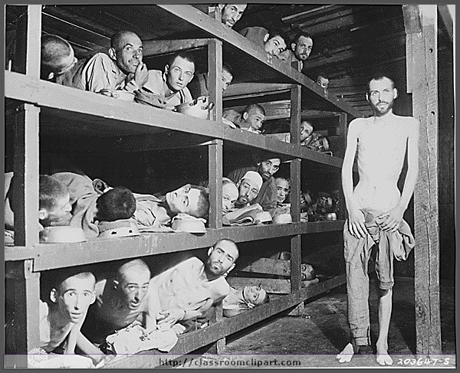
Atrocities of WWII

Slide 51
War Crimes
Any crimes committed during war
violation of preset rules of warfare
Performed against civilians or prisoners of war (POW’s)
Atrocities
Horrific acts of aggression
Senseless violence
Involved every nation in WWII

Slide 52
Allied Atrocities
American & British
Civilian Mistreatment
Fire-Bombing of Dresden
Atomic Bombing of Japan
Japan’s refusal to surrender = choice: invasion or A-Bombs
Shortened the war
Civilian targets
Mistreatment of POW’s
Some POW’s were killed after surrendering—areas of intense combat
Revenge was a factor
Asian-American Internment Camps
Soviet Atrocities
Civilian Mistreatment
“Dangerous” elements in “liberated” countries
Control territory
Eliminated resistance to Soviet control
Executed non-Communists
Revenge a factor-Germany
Execution of POW’s
Revenge against Germans
Weakened armed forces of “liberated” countries
Cold War begins due to events like these

Slide 53
Italian Atrocities
In Africa
Civilian Mistreatment
Executed nearly 1 million civilians
Believed they could control the country better
Mistreatment of POW’s
Some were killed after surrendering
Revenge was a factor
Severe treatment/starvation
In Italy
Civilian Mistreatment
Means of controlling the people
Maximized war effort
Eliminated political Rivals
Hurts Mussolini
Weakens hold on Italy as the war drags on
Citizens riot/oust him—eventually executed him

Slide 54
Japanese Atrocities
Acts on Civilians
Nanking (1937-38)
Nearly 500,000 civilians were executed
Over 10,000 Chinese were raped
Occupied Territories
Eliminated cultural and religious leadership to try to install Japanese lifestyles
Resistance suspects were rounded up and killed
Enslaved civilians for war industry
Treatment of POW’s
Wounded were often killed
Food & Water rations were minimal
Often used for forced Labor
Torture/Brain-washing for information and propaganda
Varied greatly within the Japanese military

Slide 55
Nazi Atrocities
The Holocaust
6 million Jews were murdered by the Nazis
Nazis blamed Jews for all the hardships of German History
Nazi “Final Solution” for the Jews (1942)
1. Death Camps were built to carry out mass executions
2. Used less as slave labor—starvation rations
3. Carried out by the SS—Adolph Eichmann
4. Executions increased as the Nazi Army retreated
Concentration Camps
14 million civilians were killed by the Nazis
Racial/Ethnic Minorities
Political Opponents
Resistance/Underground leaders
Intellectuals/Clergy
Were used by the Nazis
As slave labor
In experiments on nutrition, pain, genetics—Dr. Mengele
Were executed as Nazis retreated (1944-45)

Slide 56
Nazi Atrocities
Hitler’s Special Prison
Special prisoners were dealt with directly by Hitler & Nazi Leadership
Leaders of the resistance movements
Political enemies
Assassins and conspirators
Used unusually cruel methods
Decapitations
Hangings: Piano Wire, Meat Hooks, Barbed Wire
Prisoners were belittled and mocked
Executions and Mock Trials were filmed
Used to torture/intimidate other prisoners
Hitler/Nazi leaders viewed films in his theatre

Slide 57
Nazi Atrocities
Evidence
By 1942 Rumors were worldwide
Byproducts
Stockpiled items: shoes, glasses, clothing, etc.
Made things from corpses: soap, candles, rope, dyes, lamp shades, fertilizer
Mass graves and ashes from crematoriums
Found by advancing Allied Armies
Nuremberg trials
Many Nazis committed suicide
Claimed to be following orders—Nuremberg Defense
Treatment of POW’s
Enemy POW’s were often executed by SS death squads
Especially in E. Europe
More common late in WWII
Most famous incident was Malmade (Battle of the Bulge-1944)
Part of overall strategy—terror
Were human shields
Located near factories
Located near military bases
Less likely to be bombed

